Slide 1
Introduction to Data-Centric Computing
Hierarchical/Agglomerative Clustering + Dendrograms

Slide 2
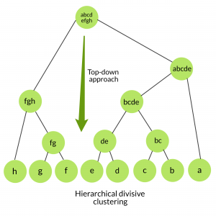
Hierarchical Clustering
Determines cluster assignments by building a hierarchy.
https://www.geeksforgeeks.org/ml-hierarchical-clustering-agglomerative-and-divisive-clustering/

Slide 3
Hierarchical Clustering
Determines cluster assignments by building a hierarchy.
This is implemented by either a bottom-up or a top-down approach:
Agglomerative clustering is the bottom-up approach.
It merges the two points that are the most similar until all points have been merged into a single cluster.
Divisive clustering is the top-down approach.
It starts with all points as one cluster and splits the least similar clusters at each step until only single data points remain.
Kevin Arvai. K-Means Clustering in Python: A Practical Guide.

Slide 4
Hierarchical Clustering (cont)
Produce a tree-based hierarchy of points called a dendrogram.
Similar to partitional clustering, in hierarchical clustering the number of clusters (k) is often predetermined by the user.
Clusters are assigned by cutting the dendrogram at a specified depth that results in k groups of smaller dendrograms.
Hierarchical clustering IS a deterministic process, meaning cluster assignments won’t change when you run an algorithm twice on the same input data.
Kevin Arvai. K-Means Clustering in Python: A Practical Guide.

Slide 5
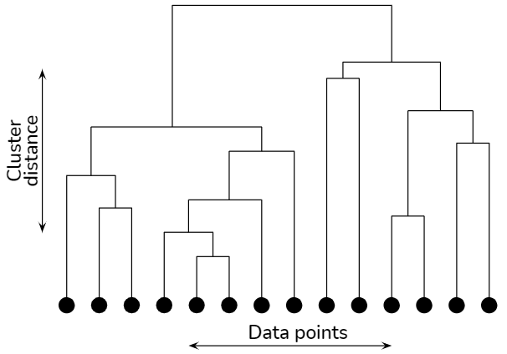
Hierarchical Clustering: Dendrogram
Prasad Pai. Hierarchical clustering explained: Illustration of analysis and procedures used in hierarchical clustering in a simplified manner.

Slide 6
Hierarchical Clustering (cont)
Strengths:
Often reveal the finer details about the relationships between data objects.
Provide an interpretable dendrogram.
Weaknesses:
Computationally expensive with respect to algorithm complexity.
Sensitive to noise and outliers.
Kevin Arvai. K-Means Clustering in Python: A Practical Guide.

Slide 7

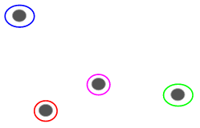
Hierarchical Clustering (HC)
Let’s say we have the below points and we want to cluster them into groups:
We can assign each of these points to a separate cluster:

Slide 8
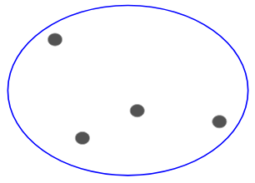
HC (cont)
Based on the similarity of these clusters, we can combine the most similar clusters together and repeat this process until only a single cluster is left:

Slide 9
HC: Dendrogram
The sole concept of hierarchical clustering lies in just the construction and analysis of a dendrogram.
A dendrogram is a tree-like structure that explains the relationship between all the data points in the system.

Slide 10
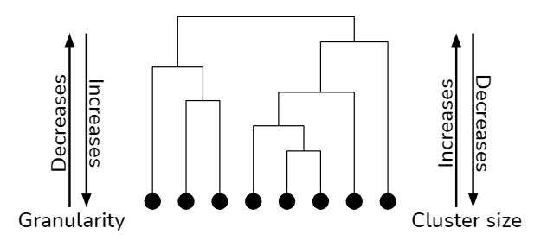
HC: Dendrogram (cont)
A dendrogram DOES NOT need to branch out at regular intervals from top to bottom
The vertical direction (y-axis) in it represents the distance between clusters in some metric.

Slide 11
HC: Dendrogram (cont)
As you keep going down in a path, you keep breaking the clusters into smaller and smaller units until your granularity level reaches the data sample.
In the vice versa situation, when you traverse in up direction, at each level, you are subsuming smaller clusters into larger ones till the point you reach the entire system.
As a result, hierarchical clustering is also known as clustering of clustering.

Slide 12
HC: Number of clusters
While constructing the dendrogram, we do not keep any assumption on the number of clusters.
Once the dendrogram has been constructed, we slice this structure horizontally.

Slide 13
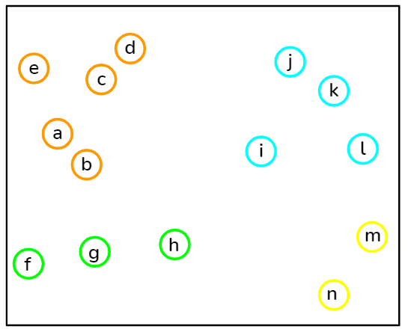
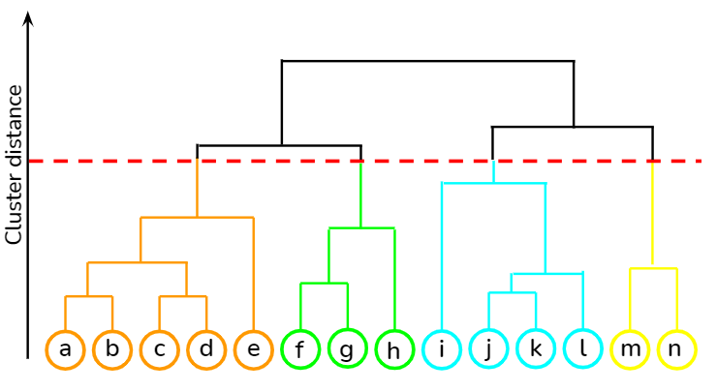
HC: Number of clusters - making the cut
Dendrograms however do not do proper justice to understand how the clusters will look like after you place the horizontal cut.
You have to individually mark the data points in a feature vector space with the resulting cluster indexes to visually see the effect of clustering.

Slide 14
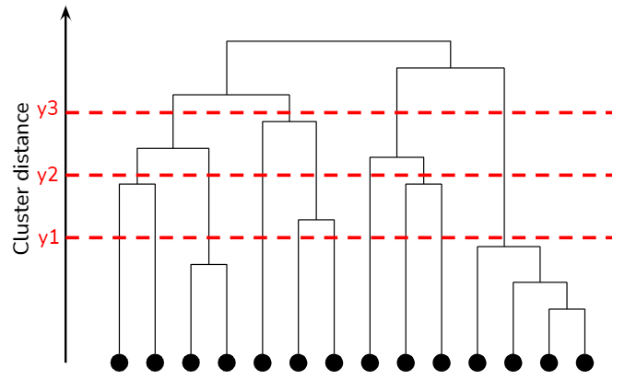
HC: Number of clusters - where to cut
Where should you place the horizontal cut.
The location of slicing can be decided visually

Slide 15
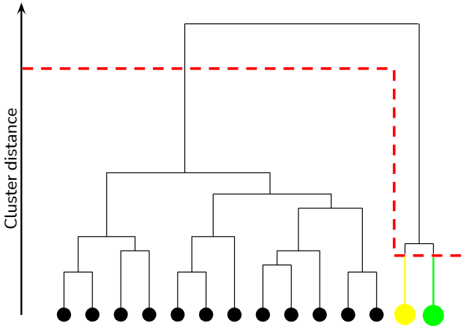
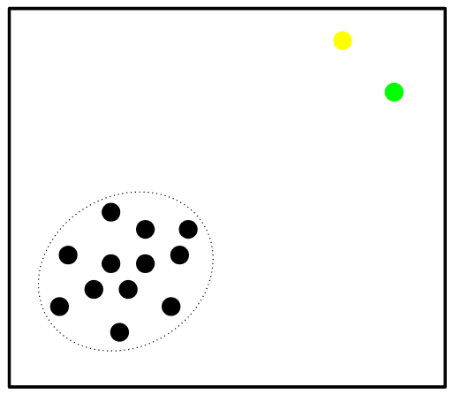
HC: Number of clusters - where to cut
It is not a constraint that you have to cut dendrogram throughout at a constant distance.
Based on the application and domain knowledge of the problem you are trying to solve, the dendrogram can be cut inconsistently.
Below in the outlier detection application, to separate a couple of outliers lying adjacently, the horizontal cut is varying at different places.

Slide 16
Interpretation of dendrogram
Each level of dendrogram has a subtle meaning to the relationship between its data members.
In a regular relationship chart, one may interpret that at the top lies grandparents or the first generation, the next level corresponds to parents or second generation and the final level belongs to children or third generation.
Likewise, in every branching procedure of dendrogram, all the data points having the membership at each level belongs to a certain class.

Slide 17
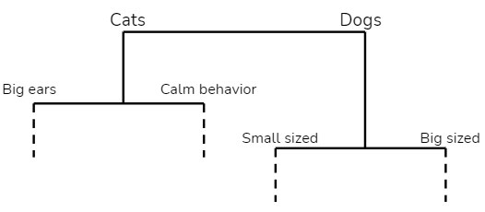
Interpretation of dendrogram (cont)
To infer this class entity, one has to go through a few individual samples of each level within the formulated cluster and find out what feature is common in the resulting cluster.
Also, these inferred classes need not be similar at the sister branches.
For example, in level 2, the cats have been clustered on big ears and calm behavior but dogs have been clustered on a similar attribute of size.

Slide 18
Construction of dendrogram
There are two ways of constructing dendrograms.
Agglomerative clustering: bottom-up construction, where you start from the bottom and keep merging the individual data points and subclusters and go all the way to the top.
Divisive clustering: top-down construction in which you start by considering the entire system as one cluster and then keep sub clustering it until you reach individual data samples.

Slide 19
Agglomerative Clustering
Single linkage algorithm.
In this algorithm, we start with considering each data point as a subcluster.
We define a metric to measure the distance between all pairs of subclusters at each step and keep merging the nearest two subclusters in each step.
We repeat this procedure till there is only one cluster in the system.

Slide 20
Agglomerative Clustering
We assign each point to an individual cluster in this technique. Suppose there are 4 data points. We will assign each of these points to a cluster and hence will have 4 clusters in the beginning:

Slide 21
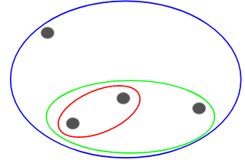
Agglomerative Clustering
Then, at each iteration, we merge the closest pair of clusters and repeat this step until only a single cluster is left:

Slide 22
Divisive Clustering
Recursive k-means.
You recursively perform the procedure of k-means on each intermediate cluster till you encounter all the data samples in the system or the minimum number of data samples you desire to have in a cluster.
In each step of this algorithm, you have to be mindful of how many clusters would you like to create next.

Slide 23
Divisive Clustering
It doesn’t matter if we have 10 or 1000 data points. All these points will belong to the same cluster at the beginning:

Slide 24

Divisive Clustering
At each iteration, we split the farthest point in the cluster and repeat this process until each cluster only contains a single point:

Slide 25
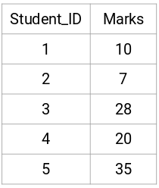
HC: Example
Let’s take a sample of five students:

Slide 26
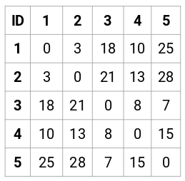
HC: Example → Creating a Proximity Matrix
First, we will create a proximity matrix which will tell us the distance between each of these points.
Since we are calculating the distance of each point from each of the other points, we will get a square matrix of shape n X n (where n is the number of observations).

Slide 27
HC: Example → Creating a Proximity Matrix
The diagonal elements of this matrix will always be 0 as the distance of a point with itself is always 0.
We will use the Euclidean distance formula to calculate the rest of the distances.
So, let’s say we want to calculate the distance between point 1 and 2:
√(10-7)^2 = √9 = 3
Similarly, we can calculate all the distances and fill the proximity matrix.

Slide 28

Steps to Perform HC: Step 1
First, we assign all the points to an individual cluster:
Different colors here represent different clusters.
You can see that we have 5 different clusters for the 5 points in our data.

Slide 29
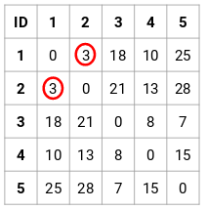
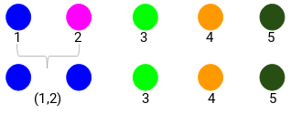
Steps to Perform HC: Step 2
Next, we will look at the smallest distance in the proximity matrix and merge the points with the smallest distance.
We then update the proximity matrix
Here, the smallest distance is 3 and hence we will merge point 1 and 2:

Slide 30
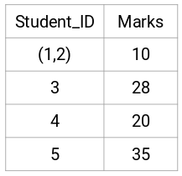
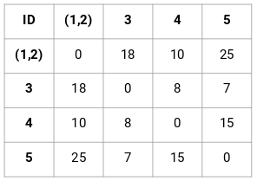
Steps to Perform HC: Step 2 (cont)
Let’s look at the updated clusters and accordingly update the proximity matrix:
Here, we have taken the maximum of the two marks (7, 10) to replace the marks for this cluster.
Instead of the maximum, we can also take the minimum value or the average values as well.
Now, we will again calculate the proximity matrix for these clusters:

Slide 31
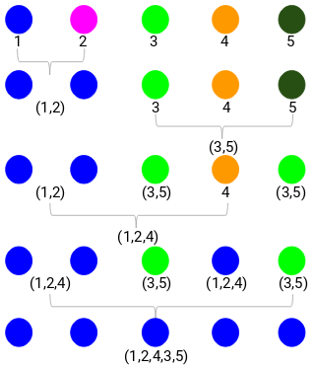
Steps to Perform HC: Step 3
We will repeat step 2 until only a single cluster is left.
So, we will first look at the minimum distance in the proximity matrix and then merge the closest pair of clusters.
We will get the merged clusters as shown below after repeating these steps:

Slide 32
Steps to Perform HC: Step 4 → # of Clusters
We started with 5 clusters and finally have a single cluster.
This is how agglomerative hierarchical clustering works.
How do we decide the number of clusters?

Slide 33
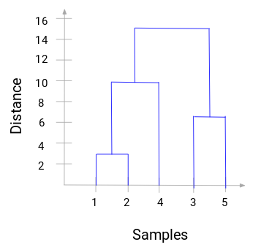
HC: Choosing the Number of Clusters
Whenever we merge two clusters, a dendrogram will record the distance between these clusters and represent it in graph form.
More the distance of the vertical lines in the dendrogram, more the distance between those clusters.

Slide 34
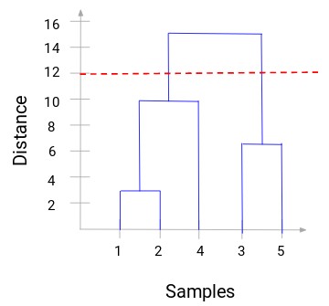
HC: Choosing the Number of Clusters
We can set a threshold distance and draw a horizontal line
Generally, we try to set the threshold in such a way that it cuts the tallest vertical line
Let’s set this threshold as 12 and draw a horizontal line

Slide 35
HC: Choosing the Number of Clusters
The number of clusters will be the number of vertical lines which are being intersected by the line drawn using the threshold.
In this example, since the red line intersects 2 vertical lines, we will have 2 clusters.
One cluster will have a sample (1,2,4) and the other will have a sample (3,5).

Slide 36
HC: Advantages
With hierarchical clustering, you can create more complex shaped clusters that weren’t possible with other approaches
You need not make any assumptions of how the resulting shape of your cluster should look like.
In one go, you can cluster the dataset first at various levels of granularity, and then decide upon the number of clusters you desire in your dataset.
If you are using a meaningful distance function (e.g., Euclidean distance) to measure the distance between your clusters, then mathematically, your clustering procedure can be very easy to understand

Slide 37
HC: Disadvantages
Heavily driven by heuristics.
Leads to a lot of manual intervention in the process and consequently, application/domain-specific knowledge is required to analyze whether the result makes sense or not.
Though HC may be mathematically simple to understand, it is a mathematically very heavy algorithm.
In any hierarchical clustering algorithm, you have to keep calculating the distances between data samples/subclusters and it increases the number of computations required.
If the number of data samples increases, then visually analyzing dendrogram and making decisions becomes impossible.

Slide 38
Links & Resources
Similarity measures: http://dataaspirant.com/2015/04/11/five-most-popular-similarity-measures-implementation-in-python/
K-Means Clustering in Python:
https://mubaris.com/2017/10/01/kmeans-clustering-in-python/
https://github.com/mubaris/friendly-fortnight
Hierarchical Clustering in Python
https://towardsdatascience.com/hierarchical-clustering-explained-e59b13846da8
https://www.analyticsvidhya.com/blog/2019/05/beginners-guide-hierarchical-clustering/
https://www.datascience.com/blog/k-means-clustering
https://stackoverflow.com/questions/32232067/cluster-points-after-kmeans-clustering-scikit-learn
https://www.naftaliharris.com/blog/visualizing-k-means-clustering/

